Slide 1
Java Basics 5
Guangjian Zhou

Slide 2
Difference between inheritance and overriding
In inheritance child class reference can hold

Slide 3
Lambda is an implementation of functional interface
An Interface that contains exactly one abstract method is known as functional interface. It can have any number of default, static methods but can contain only one abstract method.

Slide 4
Marker interface
2. Marker Interfaces
A marker interface is an interface that doesn't have any methods or constants inside it. It provides run-time type information about objects, so the compiler and JVM have additional information about the object.
A marker interface is also called a tagging interface.
Though marker interfaces are still in use, they very likely point to a code smell, and we should use them carefully. The main reason for this is that they blur the lines of what an interface represents, since markers don't define any behavior. Newer development favors annotations to solve some of the same problems.

Slide 5
54. Explain the difference between static and dynamic binding?
Abstraction
55. What is Abstraction in Object Oriented programming?
56. How is Abstraction different from Encapsulation?
57. What is an abstract class in Java?
58. Is it allowed to mark a method abstract method without marking the
class abstract?
59. Is it allowed to mark a method abstract as well as final?
60. Can we instantiate an abstract class in Java?

Slide 6
Set 5 :
47. Why Java does not allow overriding a static method?
48. Is it allowed to override an overloaded method?
49. What is the difference between method overloading and method
overriding in Java?
50. Does Java allow virtual functions?
51. What is meant by covariant return type in Java?
Polymorphism
52. What is Runtime Polymorphism?
53. Is it possible to achieve Runtime Polymorphism by data members in
Java?

Slide 7
47. Why Java does not allow overriding a static method?
Static methods cannot be overridden since they are bonded at compile time and method overriding relies on dynamic binding at runtime.
If static methods are redefined by a derived class, then it is not Method Overriding but Method Hiding.

Slide 8
48. Is it allowed to override an overloaded method?
Yes, since the overloaded method is a completely different method in the eyes of a compiler.

Slide 9
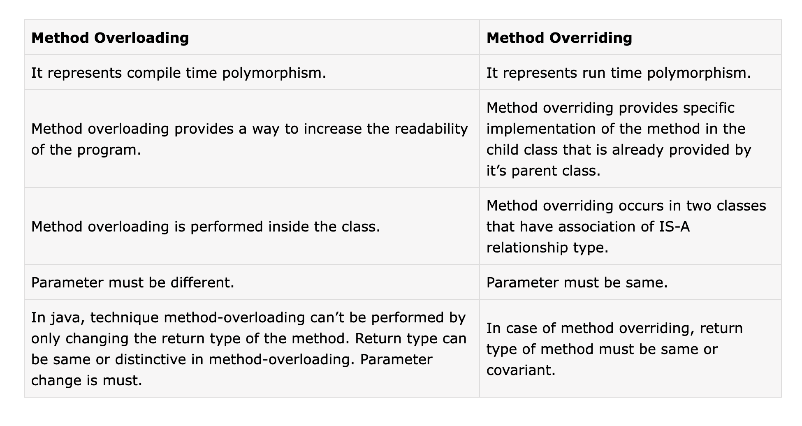
49. What is the difference between method overloading and method overriding in Java?

Slide 10
50. Does Java allow virtual functions?
By default, all the instance methods in Java are considered as the Virtual function except final, static, and private methods as these methods can be used to achieve polymorphism.

Slide 11
51. What is meant by covariant return type in Java?
Covariant return type refers to return type of an overriding method. It allows to narrow down return type of an overridden method without any need to cast the type or check the return type. Covariant return type works only for non-primitive return types.

Slide 12
52. What is Runtime Polymorphism?
overriding

Slide 13
53. Is it possible to achieve Runtime Polymorphism by data members in Java?
A method is overridden, not the data members, so runtime polymorphism cannot achieved by data members in java.

